Slide 1
Building Capacity & Strengthening WSCC Teams
A Series of Training Modules for States & Districts
YOUR NAME HERE

Slide 2
ACKNOWLEDGEMENTS
Notes:
A lot of experts, leaders and practitioners from around the country influenced and assisted with this work.
Over 28 schools at various levels of engagement with the WSCC model were interviewed to better understand the needs of the field. There were schools that did not have any type of WSCC team, School Health Team or Wellness Team. Then there were others who were very highly organized and doing exciting and impactful work that was systemic throughout their school and district. Schools that had been recognized for their work in school health by both ASCD and CDC were targeted to gain a broader understanding of the stages of implementation of the WSCC model and what schools were actually doing, accomplishing and struggling with.
An advisory committee of national experts, practitioners at the school and district level, and state level leaders was also used to help guide the work.
What was discovered was there were a number of outstanding written guides and resources available to schools for implementing the WSCC model – and those resources are highlighted and referenced in the trainings. But there was a gap in professional development to support implementation.
So these training modules were created to be used in conjunction with those WSCC implementation guide resources. School staff are busy people so hopefully these training can support the existing resources for WSCC implementation.

Slide 3
OBJECTIVES
Define a WSCC Team
Describe the purpose of the training modules
Explore the layout and content of other training modules
Explain how the training modules can be used in a variety of settings
Notes:
Review the objectives

Slide 4
WHOLE SCHOOL, WHOLE COMMUNITY, WHOLE CHILD MODEL
Notes:
For years we have known that learning and health are interrelated. Studies demonstrate that when children’s basic nutritional and fitness needs are met, they attain higher achievement levels. Similarly, the use of school-based and school- linked health centers ensuring access to needed physical, mental, and oral health care improves attendance, behavior, and achievement.
In 2007 – ASCD and CDC came together to establish greater alignment, integration, and collaboration between health and education across the school setting to improve each child's cognitive, physical, social, and emotional development. This means aligning policies, processes and practices that serve each child. To demonstrate this the WSCC model was created and depicted here.

Slide 5
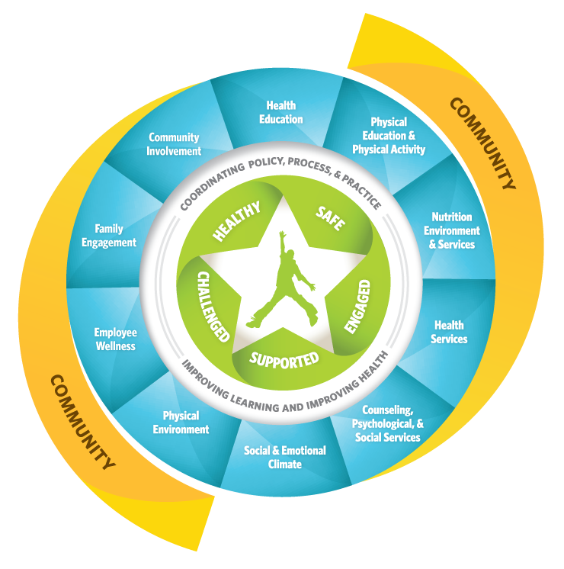
WSCC TEAM
District or School Level
Focuses on Health and Education
Strives for Representation from All 10 Components (teal sections)
Notes:
The trainings are designed for WSCC Teams –
So what is a WSCC Team - A WSCC Team can be at the school or district level but it has has members from both academic and health areas of the district or school. In many schools and districts there are existing school health teams that go by a variety of names.
If your school or district already has a team, we are not suggesting that you change the name, rather you just work to ensure the focus is on both health and academics and that the team strives to have representative from a diverse set of key stakeholders.

Slide 6
PURPOSE OF TRAINING MODULES
Provide training resources for the implementation of WSCC teams in schools and districts
Generate additional competence, confidence and motivation for building and sustaining WSCC teams.
Notes:
This set of trainings is designed to highlight some of that information in bite sized chunks of learning to create greater competence, confidence and motivation for building and sustaining WSCC Teams and the work.
While the modules were designed for implementation at the school level, they can also be used at the district level to improve WSCC teams or health at the district level.

Slide 7
TRAINING MODULES OVERVIEW
In person professional development
For use by state, district or school
Focus is on the school
One hour
Flexible/Adaptable
Notes:
These training modules are designed to serve as In person professional development. They are scripted and detailed so that virtually anyone can deliver with a little review and preparation time.
While the focus of the content is directed at the school level since that is where the children are, these training modules can be used by state, district or school level personnel.
They are meant to be flexible in their use. For example, you can use the training modules in any order. The modules were designed to stand on their own to allow schools and districts to select areas for training based on their individual needs.
The modules are designed to be one hour in length, but suggestions are provided at the end of the module for ways to reduce time if needed. Also, as you review the modules, you will see the time can be expanded for a deeper dive in the area using the additional resources provided for each module.

Slide 8
https://www.sophe.org/focus- areas/school-health/
Notes:
There are ten modules.
The modules do not need to be conducted in any specific order with the exception of the WSCC overview module. It is typically a good module to start with just to ensure a clear understanding of the module as well as some visioning and self assessment work that is included in that module.

Slide 9
TRAINING MODULES
Whole School Whole Community, Whole Child (WSCC) Overview
Making the Case - Building and Sustaining Administrative and Staff Buy-in
Organizing for Success: How to Set Up Your WSCC Team
Creating Engaging and Productive Meetings
Assessing School Health Needs
Notes:
If your school is exploring or just beginning the use of the WSCC model and team, we suggest looking at the following modules: Overview, Building Support, Organizing Teams, Meetings, Assessing
These modules help form and refresh existing teams.

Slide 10
TRAINING MODULES
Transforming Environments
Using Data to Create Action Plans and Evaluate Work
Communicating Results and Improvements
Engaging Youth
Ensuring Health Equity
Notes:
The second set of five are more for those schools who want to expand their work and thinking to other important areas of this health and education work..
These modules include
Transforming Environments or looking at how to build in policy, practice or environment change into the work.
Using Data – highlights different data sources schools can use to assess and evaluate their work.
Communicating Results - Schools are doing great work but rarely communicate what they are doing. This module provides some tools to help in communicating results.
Engaging Youth – While the WSCC model has children/students at the center, it is important to engage students in this work considering they are the recipients of the services. Students are tremendous advocates for this work but are often untapped. The youth engagement module really helps schools evaluate how engaged youth are and also helps educators learn not to dismiss kids ideas, but rather to help guide kids thinking into new and different ideas.
Ensuring Health Equity- provides basic information about health equity and the importance of viewing all health work with an equity lens.

Slide 11
MODULE LAY OUT
Training Script – content and activities
PowerPoint
Handout Packet – additional resources
All modules and respective resources will be available on the SOPHE website
Notes:
Every module is set up the same way.
Each module contains a training script with sample verbiage, activities, processing questions, and complete training plan. The training scripts all begin the same way with objectives, agenda, and materials followed by an introductory or warm up activity.
Each module also has a PPT that aligns to the script. The script is also placed in the notes section of the PPT for easy reference of the content of each slide. There are some activities within the script that do not have slides though, so the script still needs to be reviewed and used.
The final element in the Handout Packet – All handouts and note pages are included in the packet and are numbered and placed in the order in which they are used. This makes it easy for sharing and using these resources with training participants.
All training materials will be available from the Society of Professional Health Education’s (SOPHE) website.

Slide 12
SUGGESTED STRATEGY for IMPLEMENTATION
Getting Organized
Review the WSCC Team Training Modules Introduction
Read the module descriptions (pages 3-4) and module content
Decide which training modules you plan to use and in what order and create your WSCC team training plan (page 5)
Preparing to Implement and Implementing a Module
Read the module training script in its entirety first to get an overall picture of the training topic and content
Review the script with the PowerPoint and designated handouts
Adapt the training materials based on local needs
Prepare all resources for the training
Conduct the training
Evaluate the training implementation
Notes:
So to get started here are the basic steps
First you need to consider how much time you have for PD. Then review the modules and determine which modules and in what order you want to present them.
When implementing it is important to prepare. It is recommended that you review the module script first in its entirety to gain an understanding of the content and activities.
Nest review the script with the PPT and handouts.
Adapt any materials or content based on your audience’s needs
Prepare the resources for the training and then conduct the training.
Get feedback from participants on what else they still need or questions they may still have.

Slide 13
Thank You!
Your name and contact info

Slide 14
DISCLAIMER
This project was supported by Cooperative Agreement Number NU38OT000315, funded by the National Center for Chronic Disease Prevention and Health Promotion, Division of Population Health, School Health Branch, from the Centers for Disease Control and Prevention. Contents are solely the responsibility of the authors and do not necessarily represent the official views of the Centers for Disease Control and Prevention or the Department of Health and Human Services.
Notes:
Read disclaimer

